Slide 1

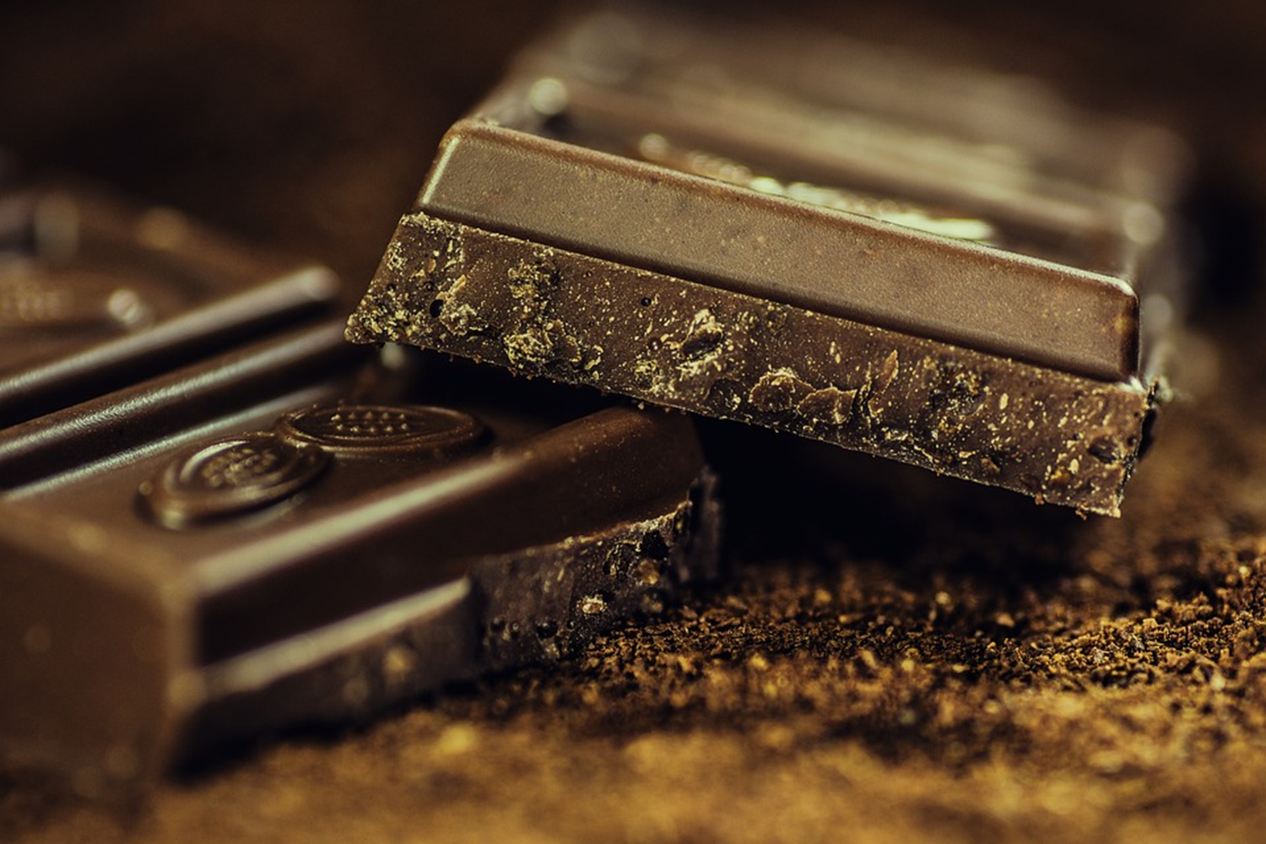



Awesome Chocolate

Slide 2


Operations Done
Quick statistics
Sales by country
Top 5 products by $ per unit
A low value Product

Slide 3
Products detail (types of chocolates with their per unit price)
Product | Price per unit
Milk Bars | $9.33
50% Dark Bites | $11.70
Almond Choco | $11.88
Raspberry Choco | $11.73
Mint Chip Choco | $8.79
Eclairs | $3.11
Drinking Coco | $6.47
99% Dark & Pure | $7.64
Orange Choco | $10.62
Spicy Special Slims | $9.00
After Nines | $9.77
Fruit & Nut Bars | $6.49
85% Dark Bars | $4.97
White Choc | $13.15
Baker's Choco Chips | $5.60
Organic Choco Syrup | $16.73
Caramel Stuffed Bars | $10.38
Manuka Honey Choco | $7.16
70% Dark Bites | $14.49
Smooth Sliky Salty | $5.79
Choco Coated Almonds | $8.65
Peanut Butter Cubes | $12.37

Slide 4
Quick Statistic
Amount Product Unit
Average $4136.23 152.2
Median $3437 124.5
Minimum $0 0
Maximum $16184 525
Range $16184 525
Product Types : 22
Average Product unit : 152
Maximum Product unit : 525
Average Sale amount : $4136.23
Maximum Sale amount : $16184

Slide 5
Units sold and Sales amount per country
Total Sales: $12,40,869
Units Sold: 45660
Country Amount($) Total Units
Australia $1,68,679 6264
Canada $2,37,944 7302
India $2,52,469 8760
New Zealand $2,18,813 7431
UK $1,73,530 5745
USA $1,89,434 10158
Max unit sold (10158) USA
Min unit sold (5745) UK
Max sales ($2,52,469) INDIA
Min sales ($1,68,679) AUSTRALIA

Slide 6
Sale of unit per Product
Product | Sum of Amount($) | Total Units
50% Dark Bites | $43,183 | 2022
70% Dark Bites | $66,500 | 2802
85% Dark Bars | $35,378 | 1044
99% Dark & Pure | $44,744 | 1956
After Nines | $66,283 | 2052
Almond Choco | $33,551 | 1566
Baker's Choco Chips | $70,273 | 2142
Caramel Stuffed Bars | $72,373 | 3207
Choco Coated Almonds | $71,967 | 2301
Drinking Coco | $52,150 | 1752
Eclairs | $63,721 | 2331
Fruit & Nut Bars | $56,644 | 1812
Manuka Honey Choco | $58,009 | 2976
Milk Bars | $47,271 | 1881
Mint Chip Choco | $62,111 | 2154
Orange Choco | $54,712 | 2196
Organic Choco Syrup | $69,461 | 2982
Peanut Butter Cubes | $69,160 | 1854
Raspberry Choco | $68,971 | 1533
Smooth Sliky Salty | $39,263 | 1683
Spicy Special Slims | $37,772 | 1308
White Choc | $57,372 | 2106
TOP 5 high value Products
Product | Sale ($)
Caramel Stuffed Bars | 72,373
Choco Coated Almonds | 71,967
Baker's Choco Chips | 70,273
Organic Choco Syrup | 69,461
Peanut Butter Cubes | 69,160
Low Sales Value Product : Almond Choco

Slide 7
THANK YOU

